Slide 1
An Embedded System Development for Field Workers Safety Detection
Embedded System Final Project
Group 7
Notes:
各位同學好，下周四 6/16 為期末報告日，以下幾點注意事項：
1. 報告順序 與 期中報告 相同
2. 使用 webex 分享螢幕功能，以投影片報告
3. 若有準備 demo 影片，亦可於報告過程中展示
4. 內容應含「題目、成員、動機(簡述)、架構說明、 成果展示」
5. 每組 7min 報告 + 1~2min QA討論，老師亦可能於報告過程中提問
6.請於當天 6/16 23:59 前，將整個專案和報告投影片，由組長代表，上傳至 github classroom，連結： https://classroom.github.com/assignment-invitations/2bec6b0a776c473f638ab41cabe22865

Slide 2
Outline
Motivation
System Structure
Demonstration
Conclusion

Slide 3
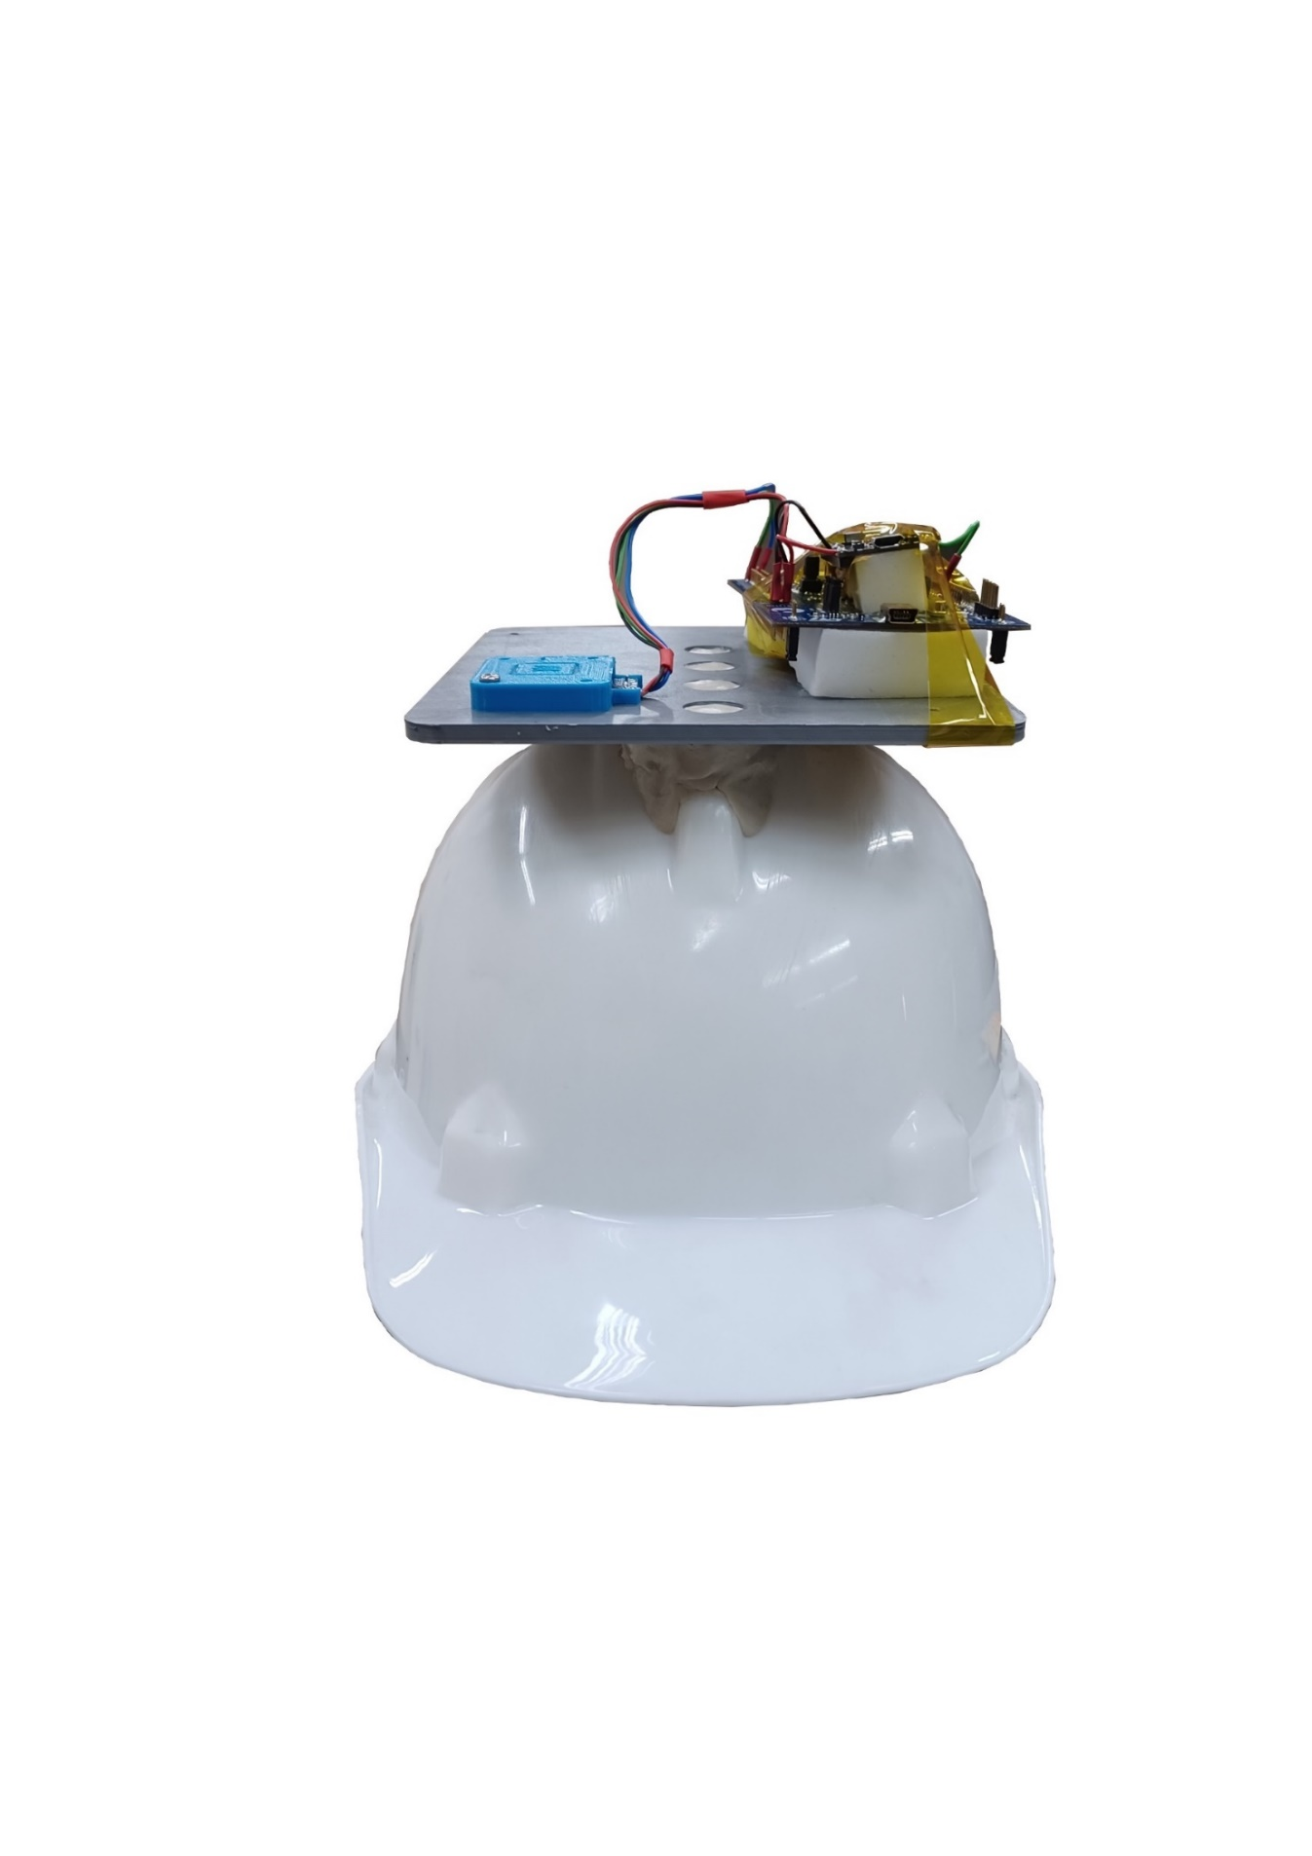
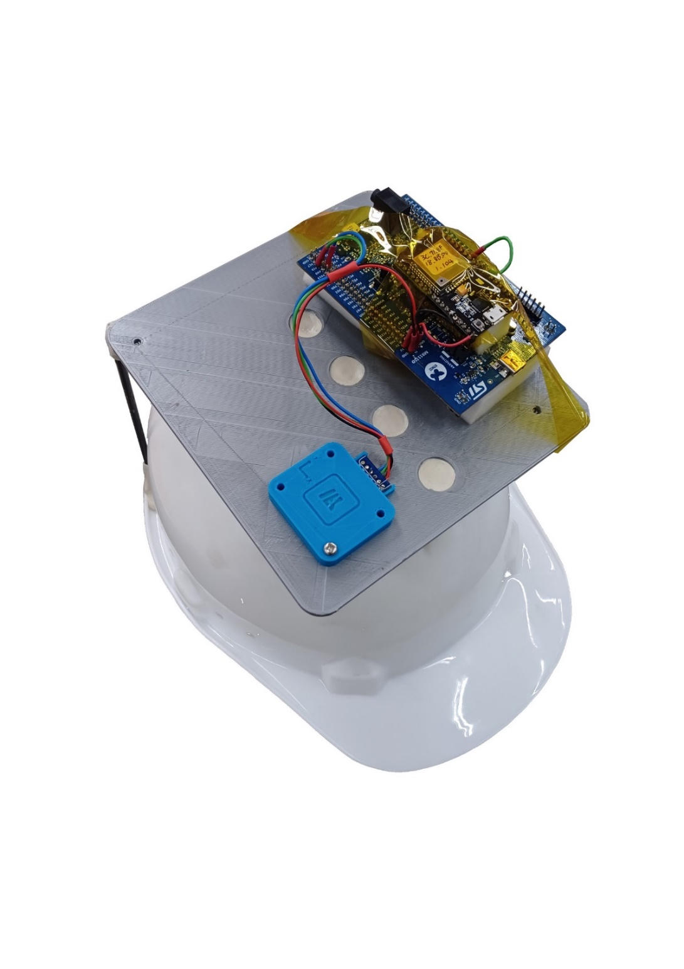
Motivation
Workplace accidents are sometimes due to insufficient manpower allocation and confined space. For these conditions, it may cause more damage if the worker cannot seek rescue in time.
Wearable devices like wristbands, watches and necklaces are not allowed in workplace.
Hence, we’re trying to propose a fall detection system, which should achieve these design features:
Low cost
Lightweight
Low power consumption
Real-time monitoring
Automatic alarm systems

Slide 4

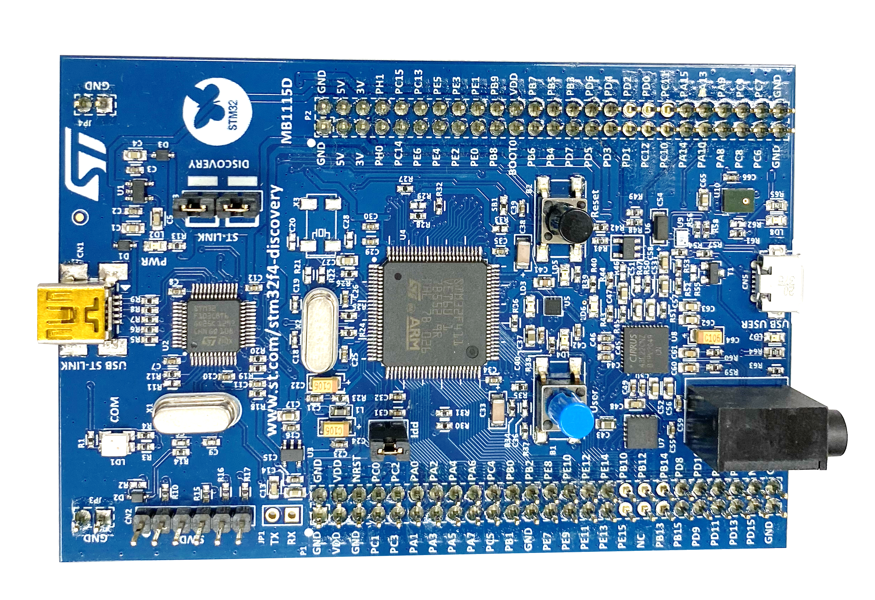
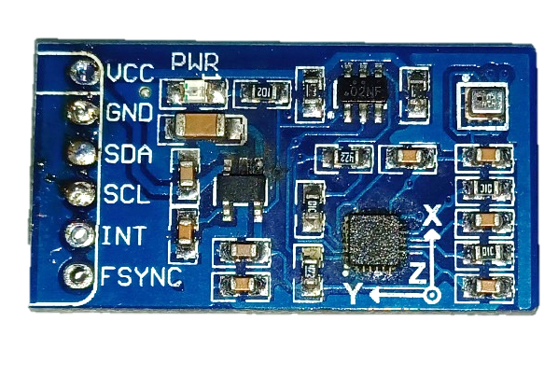
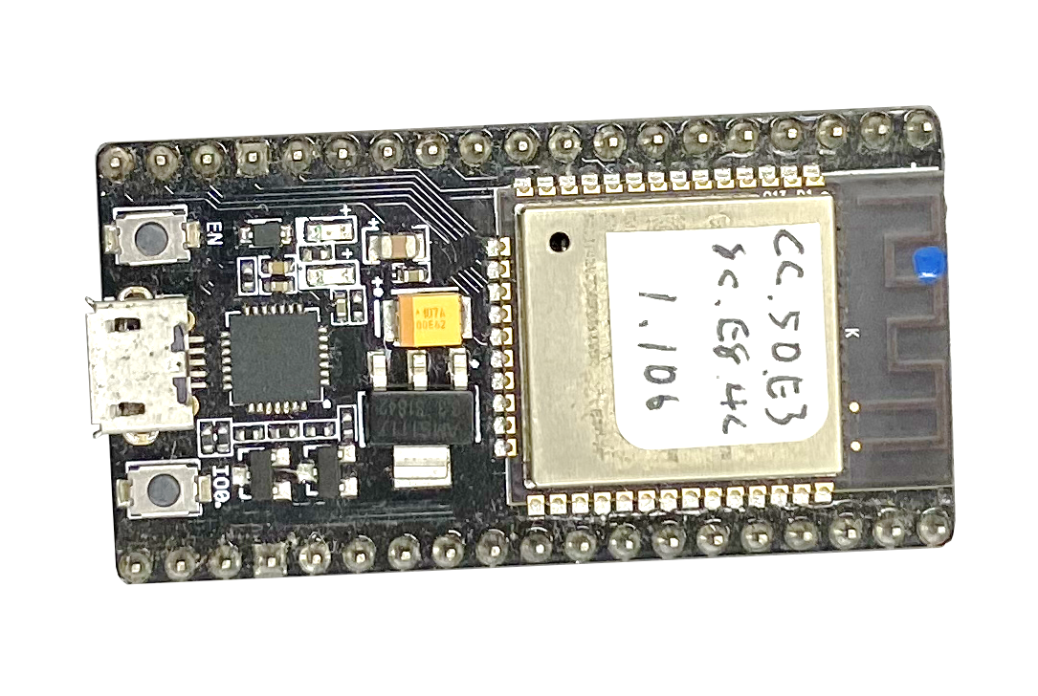
System Structure - Block Diagram
WiFi
GUI monitor
+
Alarm
Host
Head-mounted Device
IMU (MPU9255)
MCU
(STM32F411VE)
WiFi Device
(ESP32)
Acceleration
Angular Velocity
Magnetic Field
Attitude
Fall Alarm
I2C
UART
VCC
GND
SDA
SCL
5V
GND
PC9 (I2C3, SDA)
PA8 (I2C3, SCL)A
5V
GND
PA2 (huart2, Tx)
5V
GND
GPIO16 (Rx2)

Slide 5
System Structure – I. UART Communication
STM32F411VE (UART Transmitter, Tx)
UART Transmitter (Tx)
typedef struct DataPackage
{
double qua[4];
double acc[3];
int status;
} Data_t;
Data_t UART_Tx;
UART_HandleTypeDef *phuart = &huart2;
const char start_byte = 's';
const char finish_byte = 'f';
char str = ‘s’;
↓
1byte: 0111 0011
0111 0011
‘s’
sizeof ( Data_t ) bytes
‘f’
UART Receiver (Rx)
HAL_UART_Transmit(phuart, (uint8_t*) (&start_byte), 1, 10);
HAL_UART_Transmit(phuart, (uint8_t*) (&UART_Tx),
sizeof(Data_t), HAL_MAX_DELAY);
HAL_UART_Transmit(phuart, (uint8_t*) (&finish_byte), 1, 10);
uint8_t buf = 0b01110011;
char dest = (char) buf;

Slide 6
System Structure - Block Diagram
WiFi
GUI monitor
+
Alarm
Host
Head-mounted Device
IMU (MPU9255)
MCU
(STM32F411VE)
WiFi Device
(ESP32)
Acceleration
Angular Velocity
Magnetic Field
Attitude
Fall Alarm
I2C
UART
VCC
GND
SDA
SCL
5V
GND
PC9 (I2C3, SDA)
PA8 (I2C3, SCL)A
5V
GND
PA2 (huart2, Tx)
5V
GND
GPIO16 (Rx2)

Slide 7
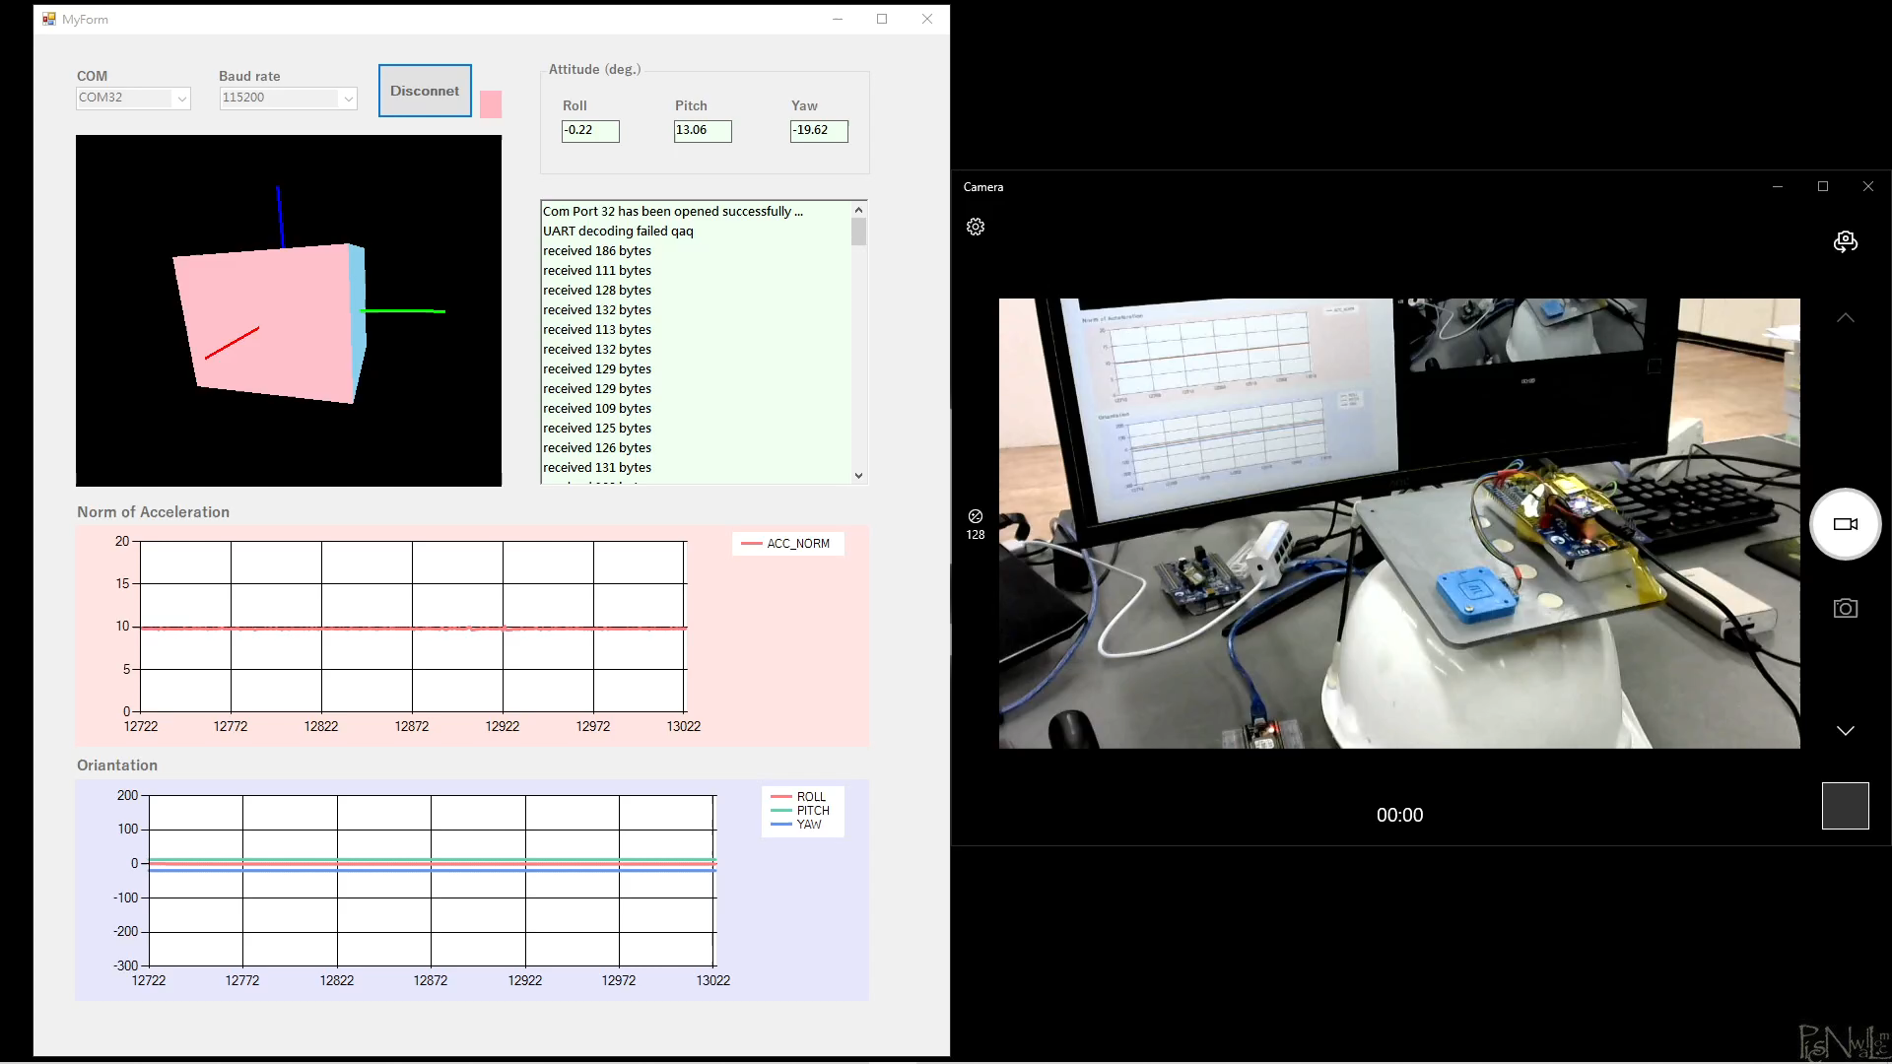
System Structure – II. AHRS
IMU Sensor: MPU9255
3-Axis Accelerometer + 3-Axis Gyroscope + 3-Axis Magnetometer
(Acceleration) (Angular Velocity) (Magnetic Field)
For obtaining the orientation of the body, the attitude and heading reference system (AHRS) algorithm is developed.
Notes:
接了MPU ( IMU慣性量測元件 ) 九軸 (三軸加速度、角速度、磁場) 的資訊，強調一般 IMU 並沒有辦法提供物體在空間中的相對擺向 (即：姿態)，根據這個目的，基於九軸的資訊開發了 AHRS 演算法算出六自由度的姿態 。

Slide 8
System Structure - Block Diagram
WiFi
GUI monitor
+
Alarm
Host
Head-mounted Device
IMU (MPU9255)
MCU
(STM32F411VE)
WiFi Device
(ESP32)
Acceleration
Angular Velocity
Magnetic Field
Attitude
Fall Alarm
I2C
UART
VCC
GND
SDA
SCL
5V
GND
PC9 (I2C3, SDA)
PA8 (I2C3, SCL)A
5V
GND
PA2 (huart2, Tx)
5V
GND
GPIO16 (Rx2)

Slide 9
System Structure – III. Fall Detection
Fall Detection Algorithm
Alg. 1 Status Judgement
RocknRoll
pitch or roll changes > 60 deg in 0.5 s
Sleep
pitch and roll average increments < 1.5 deg for 8 s
Impact
Acc_norm > 5g
Alg. 2 Fall Detection
Fall cond. 1
RocknRoll happens after Impact, in 2 s
Fall cond. 2
Sleep happens after Impact
AHRS
IMU
flags
alarm
Notes:
接了MPU ( IMU慣性量測元件 ) 九軸 (三軸加速度、角速度、磁場) 的資訊，強調一般 IMU 並沒有辦法提供物體在空間中的相對擺向 (即：姿態)，根據這個目的，基於九軸的資訊開發了 AHRS 演算法算出六自由度的姿態 。

Slide 10
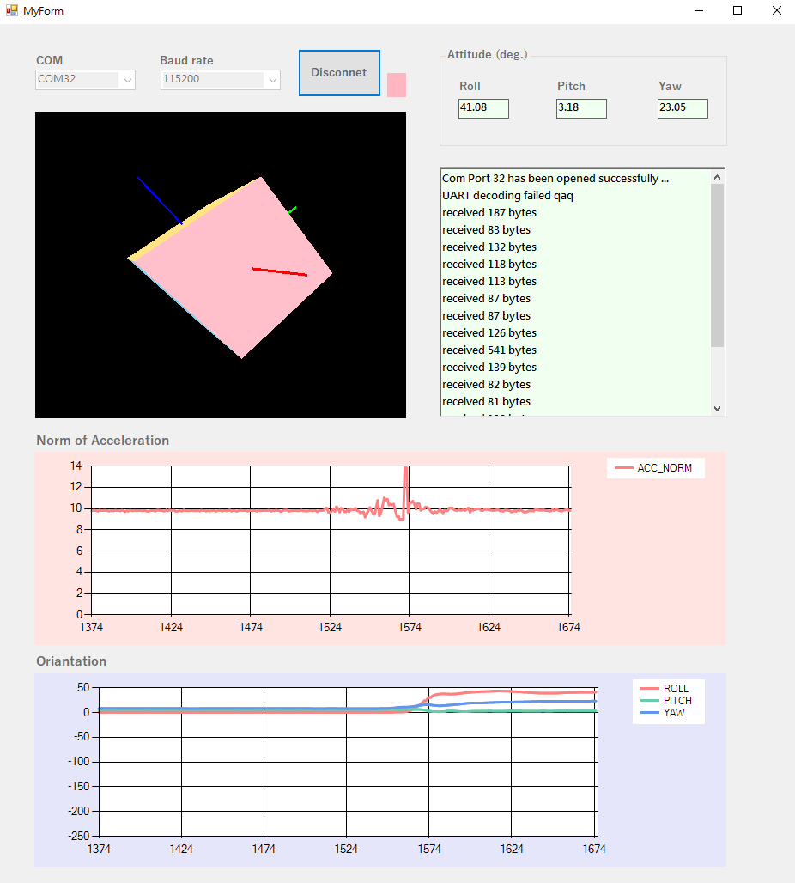
GUI – Real-Time Pose Monitor
C++/CLI
Norm of Acceleration
Body Orientation Displayer
Orientation

Slide 11
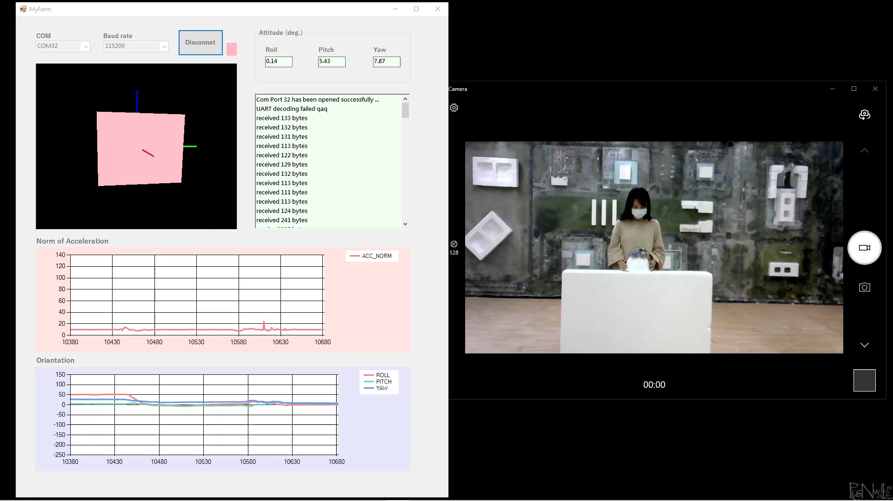
System Demonstration
Impact + Sleep

Slide 12

System Demonstration
RocknRoll + Impact

Slide 13
Conclusion
The communication library based on the I2C protocol for STM32F411VE-MPU9255 is developed.
Developed the AHRS algorithm used for motion detection and pose estimation in head-mounted devices, on the basis of IMU measurements.
Furthermore, the safety detection algorithms for field workers are presented.
Implemented the UART communication between STM32F411VE and the other embedded devices (ESP32) such that the system information can be passed into the PC Host by WiFi.
On the PC side, the real-time pose monitor is established.

